Slide 1
Amazon game recommender system CS 505 final project
Group member: Leshen Sui, Zheming Sun

Slide 2
Objective of this project: 1. Predict how users will rate games they didn't know before.
2. Recommend users game apps they may interest in. We expect users will give high ratings to what we recommend to them.

Slide 3
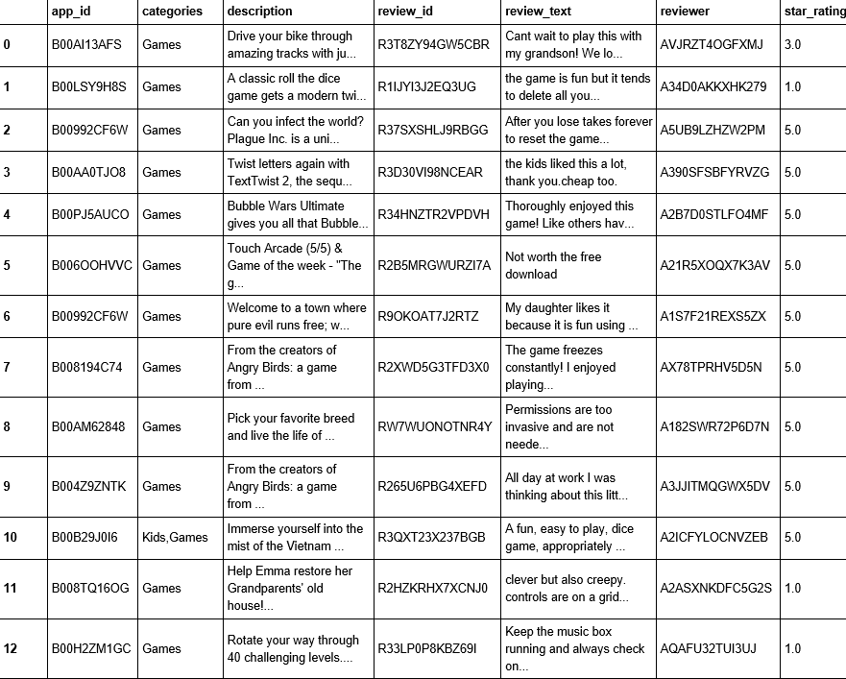
Dataset
Amazon apps review dataset
Only select apps whose category is “Game”
Some rows have missing star values or missing reviews
Delete rows if “review_text” field is “nan”.

Slide 4
Data preprocessing
Predict missing star-rating based on review text
Text processing, including stemming, removing stopwords, and TF-IDF vectorizing.
Construct document-term matrix.
Apply different classification algorithms and compare results.
average error = avg(|y_{true} - y_{predicted}|)

Slide 5
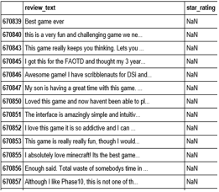
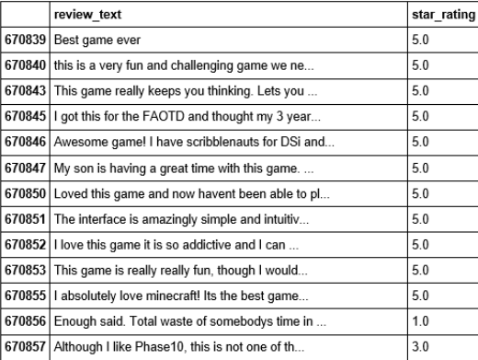
Missing star rating prediction based on logistic regression:

Slide 6
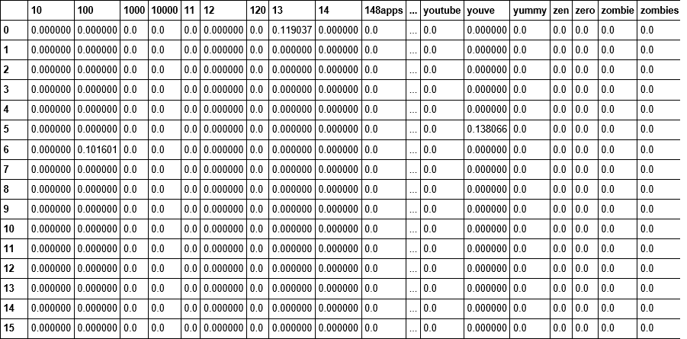
Recommendation based on clustering
High level idea: users who give a high star rating on a game may also love similar type of games.
Clustering games based on their descriptions(text processing again).
For every cluster, rank games by their average ratings.
The top-10 apps are what we are going to recommend to users if they give a 5 star-rating to an app in the same cluster.

Slide 7
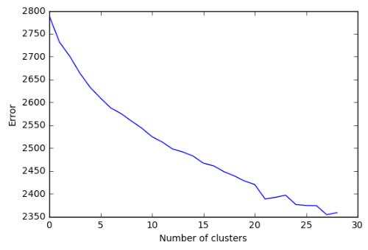
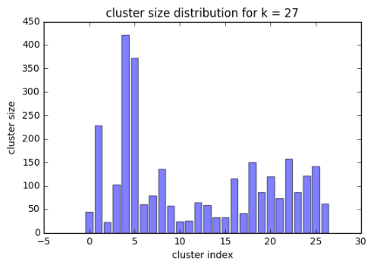
Recommendation based on clustering
Apply k-means algorithm, cloosing k = 27 by elbow method.
Make sure that cluster sizes do not differ too much
Print hot terms for each cluster and try to label each cluster

Slide 8

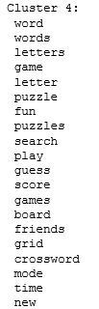
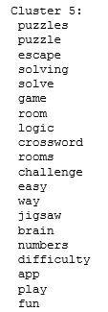
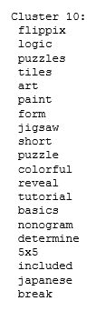
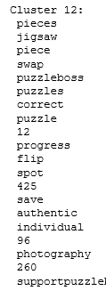
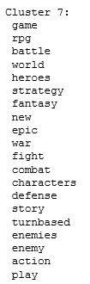
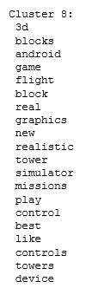
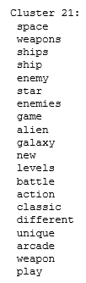
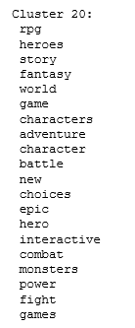


Slide 9
Model Analysis
Advantages:
Games we recommended are similar in category(avoid the case that a reviewer provides a high star rating on sports game but we recommend him angry bird).
Games we recommended have high quality(highly rated by other reviewers).
Drawbacks:
·Over conservative. Only games that have high star rating will show up on the recommendation list.
·Users are only recommended with games in same categories. No way to do out-category recommendation.

Slide 10
Recommendation based on regression
Objective: predict how a user will rate a game based on information about the game and the user.
Dependent variable: star rating
Features: average rating of each user(userAvg), average rating of each game(itemAvg), number of reviews of a game (gamePopularity), number of reviews given by a user(purchaseFrequency).
Intuition of features:
Higher userAvg →higher chances for another high rating
Higher itemAvg → better the game
More number of reviews received → more popular the game
More reviews given → more frequent purchase of a user
·Apply different classification techniques
·Linear regression perform the best.

Slide 11
Recommendation based on regression
We evaluate our model based on cross-validation
Split our training set into 10 piles. Each time we use 9 piles to train our model, and the rest one pile for testing.
Use MSE(mean square error) to evaluate the performance
Average test MSE = 0.79

Slide 12
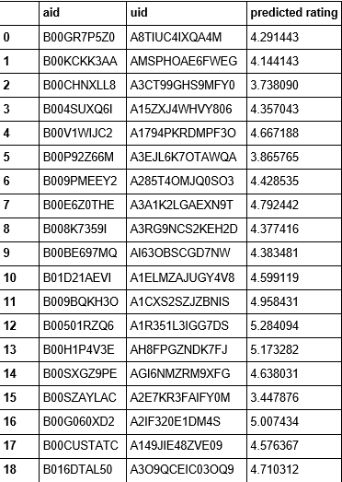

Predict star ratings for previous model
Use regression model to predict recommendations generated by clustering and ranking
We expect the average predicted rating to be much higher than global average.
global average rating = 4.04(everyone loves game)
predicted rating for our recommendation = 4.5

Slide 13
Future Works
We tried to predict unknown star ratings based on matrix factorization, but the user-item matrix is huge and sparse so it takes forever to run our algorithm. We’ll explore more methods to reduce the dimensionality. One possible way would be clustering all games on description, and then predicting how a user will rate a cluster of game.
Another approach we don’t have time to try is collaborate filtering. By clustering descriptions we can get different types of games, and we can compute users’ bias towards different types of games, the predicted rating would be global average plus user bias.

